Slide 1
LAB ACTIVITY-10
By: Amogh Garg (2020UCO1688)

Slide 2
OBJECTIVE AND METHODOLOGY
OBJECTIVE: Build confidence to use a standard spoken form of English to face job interviews, and workplace interactive situations besides enabling the learner to pursue advanced professional courses.
METHODOLOGY: Choose a topic of your choice and make a power point presentation on it.

Slide 3
MACHINE LEARNING
Basic Machine Learning Definitions-
1.Machine learning is programming computers to optimize a performance criterion using example data or past experience. Machine learning can automatically detect patterns in data, and then to use the uncovered patterns to predict future data or other outcomes of interest.
2.“Machine Learning at its most basic is the practice of using algorithms to parse data, learn from it, and then make a determination or prediction about something in the world.”
3.“Machine learning is the science of getting computers to act without being explicitly programmed.”
4.“Machine learning is based on algorithms that can learn from data without relying on rules-based programming.”
5.“Machine learning algorithms can figure out how to perform important tasks by generalizing from examples.”
6.“The field of Machine Learning seeks to answer the question “How can we build computer systems that automatically improve with experience, and what are the fundamental laws that govern all learning processes?”

Slide 4
Overview of Machine Learning
Why Machine Learning?
Machine Learning vs Others
Organizations/governments are collecting a lot of data
Information from data is being used to take key business/ political decisions
At lower levels in organization, data is used for MIS reporting
At higher levels data based prescriptive and predictive models are being built
Machine learning is the most popular technique of creating these predictive and prescriptive model
Machine Learning Vs. Statistics
• Traditional Statistics focuses on provable results with mathematical assumptions, and care less about computation • “Statistics: A useful tool for Machine Learning”
Machine Learning Vs. Artificial Intelligence • “Machine Learning is one possible route to realize AI”
Machine Learning Vs. Data Mining • Traditional DM focuses on provable results with math assumptions along with efficient computation in large dataset • “Difficult to distinguish ML and DM in reality”

Slide 5
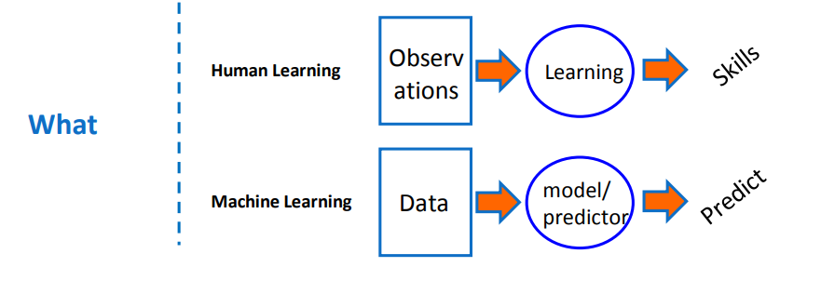
What is ML?

Slide 6


Examples
Machine learning based on statistics is basically attempting to find the relationship between input and output variables

Slide 7
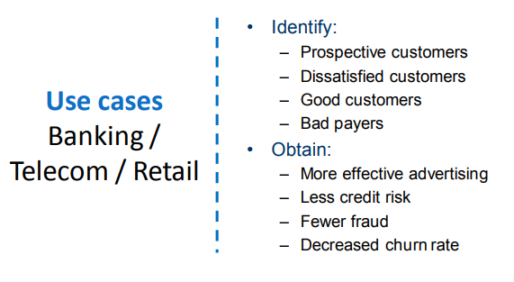
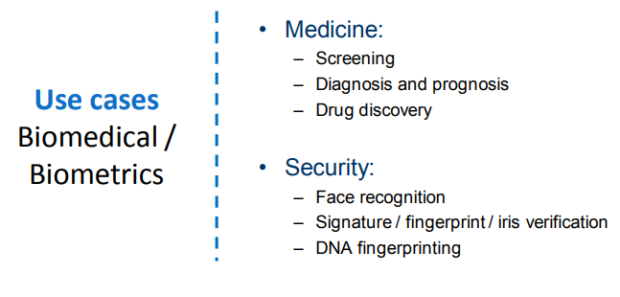
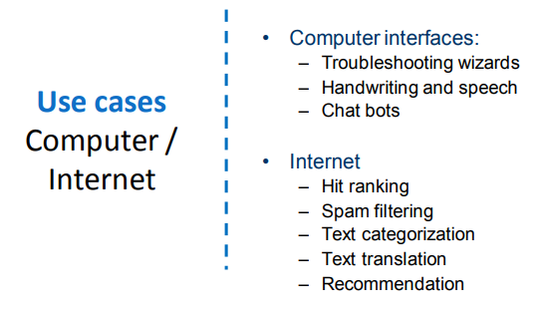

Slide 8
Choice of ML Model
f(x) defines the relationship between dependent and independent variables.
Choice of model for estimating will depend on whether we want to predict or infer. •
For Prediction, accuracy of predicted function is the most important •
For Inference, interpretability of predicted function is most important
For example, linear regression is simple to interpret but may not give very accurate predicted values of Y .
Whereas highly non-linear models may be predicting very accurately but the relationship may be very difficult to interpret

Slide 9
Types of Learning
Supervised Vs Unsupervised
Supervised Learning: • Supervised learning is where you have input variables (x) and an output variable (Y) and you use an algorithm to learn the mapping function from the input to the output. • The goal is to approximate the mapping function so well that when you have new input data (x) that you can predict the output variables (Y) for that data.
Unsupervised Learning: • Unsupervised learning is where you only have input data (X) and no corresponding output variables. • The goal for unsupervised learning is to model the underlying structure or distribution in the data in order to learn more about the data.

Slide 10
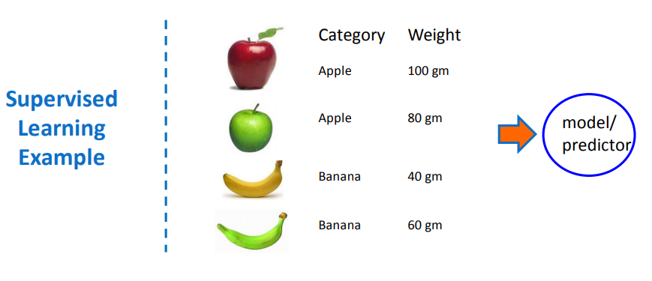
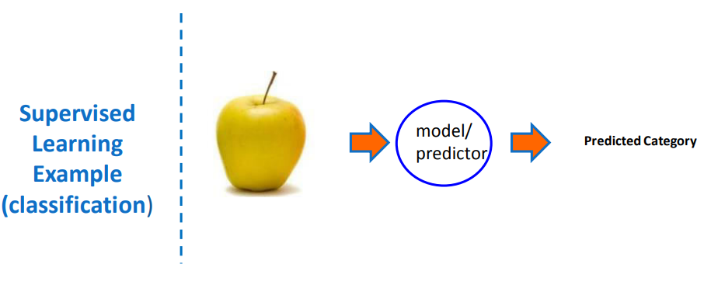
Supervised Learning Example

Slide 11
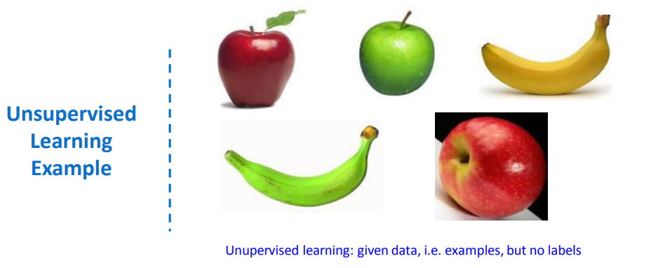
Unsupervised Learning Example

Slide 12
Classification vs Regression
Classification is a process of finding a function which helps in dividing the dataset into classes based on different parameters. In Classification, a computer program is trained on the training dataset and based on that training, it categorizes the data into different classes.
The task of the classification algorithm is to find the mapping function to map the input(x) to the discrete output(y).
Example: The best example to understand the Classification problem is Email Spam Detection. The model is trained on the basis of millions of emails on different parameters, and whenever it receives a new email, it identifies whether the email is spam or not. If the email is spam, then it is moved to the Spam folder.
Regression is a process of finding the correlations between dependent and independent variables. It helps in predicting the continuous variables such as prediction of Market Trends, prediction of House prices, etc.
The task of the Regression algorithm is to find the mapping function to map the input variable(x) to the continuous output variable(y).
Example: Suppose we want to do weather forecasting, so for this, we will use the Regression algorithm. In weather prediction, the model is trained on the past data, and once the training is completed, it can easily predict the weather for future days.

Slide 13
Classification vs Regression
Classification Models
Regression Models
Logistic Regression
K-Nearest Neighbours
Support Vector Machines
Kernel SVM
Naïve Bayes
Decision Tree Classification
Random Forest Classification
Simple Linear Regression
Multiple Linear Regression
Polynomial Regression
Support Vector Regression
Decision Tree Regression
Random Forest Regression

Slide 14
Steps in building ML Model
Problem formulation
2. Data Tidying
3. Pre-Processing
4. Train-Test Split
5. Model Building
6. Validation and Model Accuracy
7. Prediction

Slide 15
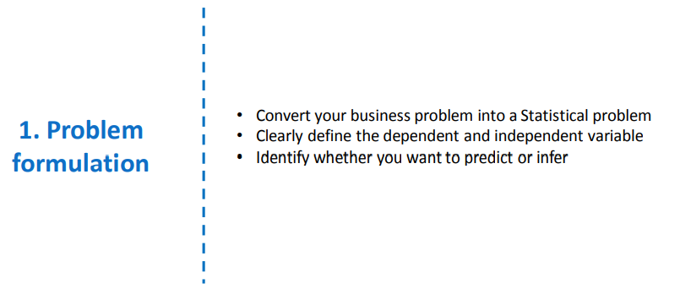
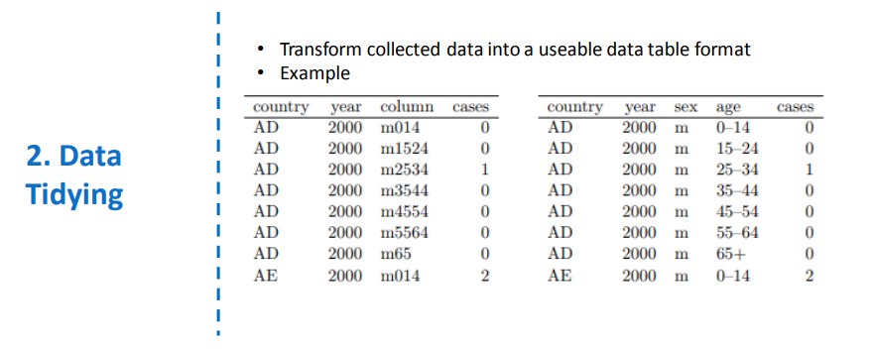

Slide 16
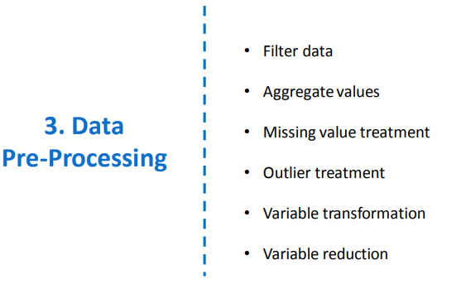
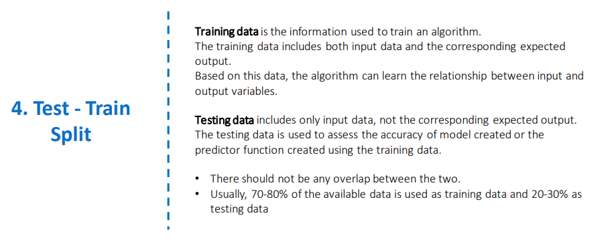

Slide 17
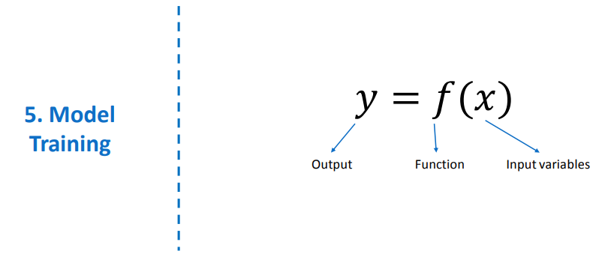
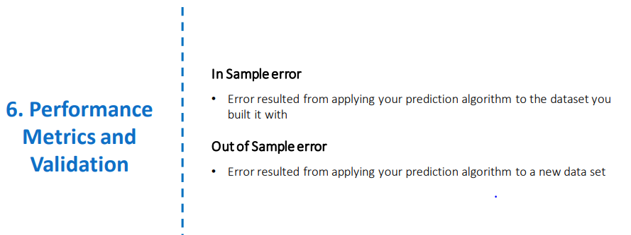
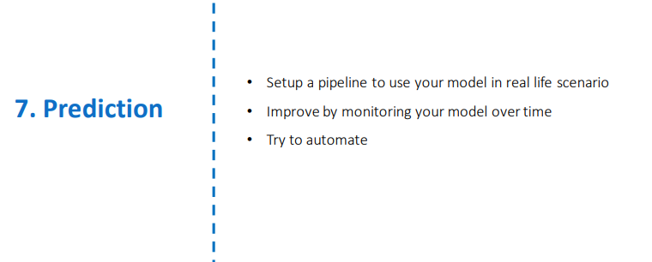

Slide 18
Scope Of Machine Learning
Robotics-Robotics is one of the fields that always gain the interest of researchers as well as the common. In 1954, George Devol invented the first robot that was programmable and it was named as Unimate. After that, in the 21st century, Hanson Robotics created the first AI-robot, Sophia. These inventions were possible with the help of Machine Learning and Artificial Intelligence.
Quantum Computing-We are still at an infant state in the field of Machine Learning. There are a lot of advancements to achieve in this field. One of them that will take Machine Learning to the next level is Quantum Computing. It is a type of computing that uses the mechanical phenomena of quantum such as entanglement and superposition. By using the quantum phenomenon of superposition, we can create systems (quantum systems) that can exhibit multiple states at the same time. On the other hand, entanglement is the phenomenon where two different states can be referenced to each other. It helps in describing the correlation between the properties of a quantum system.
Computer Vision-As the name suggests, computer vision gives a vision to a computer or a machine. Here comes into our minds what the Head of AI at Google, Jeff Dean, has once said, ‘ The progress we’ve made from 26% error in 2011 to 3% error in 2016 is hugely impactful. The way I like to think is, computers have now evolved eyes that work.’

Slide 19
THANK YOU!

